Slide 1
NEW YORK PAID FAMILY MEDICAL LEAVE
UPCOMING CHANGES
Presented by:
Add Names
November 2020
NEW YORK PAID FAMILY MEDICAL LEAVE
UPCOMING CHANGES
Presented by:
Add Names
November 2020

Slide 2
Agenda
Welcome
Background
NYPFL Overview
First Steps
Work Schedules
Shadow Leave
Compensation Plan
Keeping Track of NYPFL Days
Supplement
Timeline
Additional Resources

Slide 3
Welcome
Introductions
What’s your favorite cold-weather activity?

Slide 4
background
Project Purpose: Compliance with 2021 NYS Requirements
Relevant Details:
New rate of pay calculation – NYPFL will pay as a daily rate
Based on actual wages prior to going on the leave
Most people will see little to no change in their current rate
No rate decreases for employees currently on the leave

Slide 5
First steps
Notify Medical Leaves Administration (MLA)
MLA will place the worker on leave
The worker will stay on leave until their claim is closed
All NYPFL days will be tracked via Time Off entries
If the worker is salaried, and doesn’t work a five-day Monday-Friday workweek, share this with MLA and work with your HR rep to assign the appropriate work schedule calendar.
Once the worker is placed on leave, the daily rate will populate on the compensation tab

Slide 6
Current Process: Intermittent leaves
Place on leave (HR Rep)
Enter time off (EE/Pay Rep/HR)
Return from leave (Hr REP)
Repeat

Slide 7
New process (in January)
Place on leave
(MLA)
Enter time off Ongoing as needed (Pay Rep/HR/
manager)
Return from leave
(MLA)

Slide 8
What next?
MLA has placed the worker on leave. A work schedule has been assigned (if needed)
How can I see the worker is on leave?
How can I see the daily rate?
How do I show an NYPFL day is taken

Slide 9
Workday navigation – Shadow leave
Because NYPFL is an intermittent leave, it is set up as a “shadow leave”
When an employee is on NYPFL, “on-leave” will not display next to the person’s name
Leave status can be viewed on the time off tab of the worker profile

Slide 10
Time off tab
View “Leave of Absence Requests” requests section to see NYPFL status

Slide 11
Compensation
NYPFL pays at 67% of an average weekly wage. The NYS formula to calculate the benefit is a daily rate based on actual pay in the 8 weeks preceding the leave.
If you have access to compensation information, view the NYPFL daily rate by navigating to the compensation tab on the worker profile.

Slide 12
Entering NYPFL Days used
Keep track of NYPFL time taken by entering NYPFL time off
NYPFL time
Always defaults to 1 day – this cannot be changed
Did you know? NYS requires NYPFL to be taken in full-day increments.
Supplement time
Enter in hours (BW)
Enter in portion of a day (SM)
Multiple jobs
The NYPFL time off is not job-based, so even if the employee has multiple jobs, time off only needs to be entered once for the worker
Supplement (HAP, Vacation, etc.) can be used from either position (if available)

Slide 13
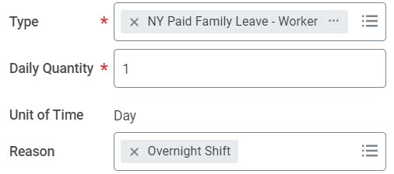
Time off – Bi-Weekly (hourly) Process
Once the employee is on leave, the Manager or Pay Rep must enter time off
Select the time off plan of NY Paid Family Leave – Worker
Daily quantity will default to one day
If an overnight worker, choose the reason “Overnight Shift”
If the employee is supplementing, supplement can be added. Calculate the amount needed. A new NYPFL supplement calculator is available (mentioned later in this presentation).

Slide 14
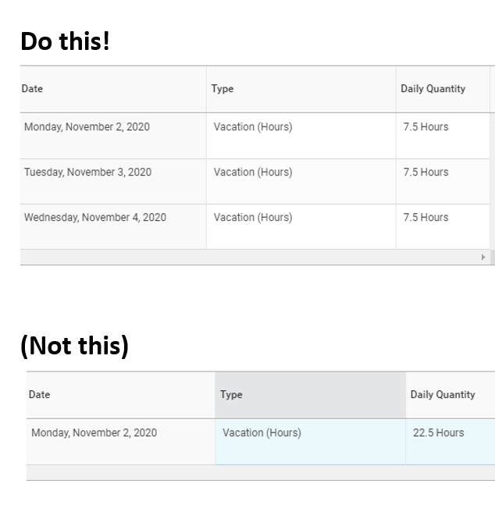
Time off should reflect days normally worked
Ensures accurate reporting
Ensures accurate NYPFL rate

Slide 15
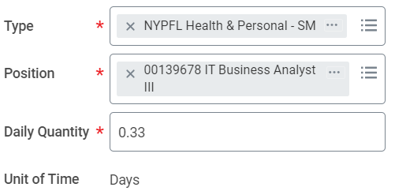
Time off – Semi-monthly (salaried) Process
Once the employee is on leave, the Manager or HR Partner must enter time off
Select the time off plan of NY Paid Family Leave – Worker
Daily quantity will default to one day
If the employee is supplementing, do not use the regular HAP and Vacation time off types, use NYPFL Health & Personal or NYPFL Vacation. These special time off types will ensure the employee receives pay above and beyond the NYPFL daily rate.

Slide 16
Make sure to enter supplement on Time for salaried workers
Normally when you enter supplement for SM employees, it doesn’t have an impact on pay
NYPFL supplement time off types will pay supplement above and beyond regular rate
Check the payroll calendar. Be sure to submit time before SM check is calced.
Supplement entered on time = paid on time

Slide 17
Daily rate of pay for Salaried employees
Daily Rate – Variances Between Paychecks for Semi-Monthly (SM) Workers
SM workers may see differences from paycheck to paycheck once we convert to a daily rate. This is because the number of working days in each pay period can vary. Over the course of the claim this will balance out, but is different from the constant benefit level across pay periods today.
Example for $78k salary worker; with current rate converted to an equivalent NYPFL daily rate of $200/day:

Slide 18
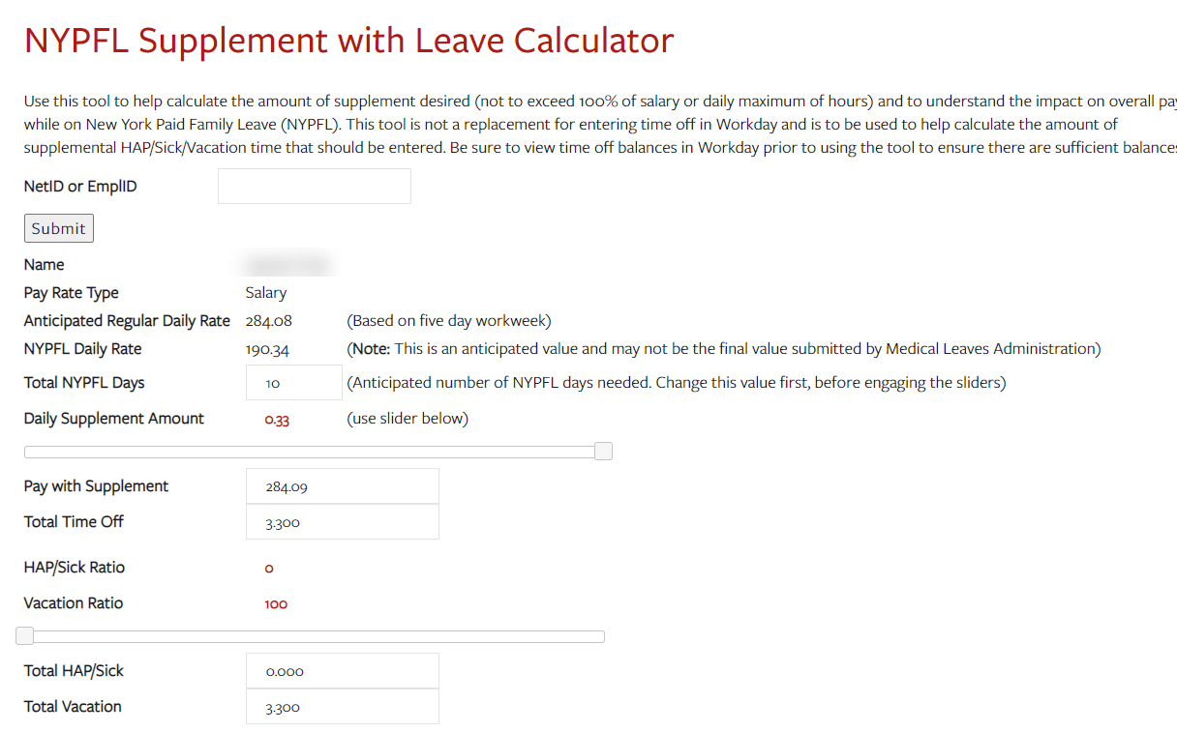
Supplement calculator
Additional tool available to help calculate the amount of supplement & impact on pay (if needed)
Available to the employee on leave, HR& Pay Reps
Engage sliders to see different supplement/pay scenarios

Slide 19
Time off validations
Safeguards in place to ensure the employee is paid correctly
Some common things to consider if you’re getting an error:
Time worked cannot be entered on a NYPFL day (unless overnight employee)
Regular vacation and HAP cannot be used on a NYPFL day for SM employees (use NYPFL vacation and HAP)
NYPFL days can only be entered under the effective date range for the leave
NYPFL time off must be entered as 1 day for each day used (this will default)

Slide 20
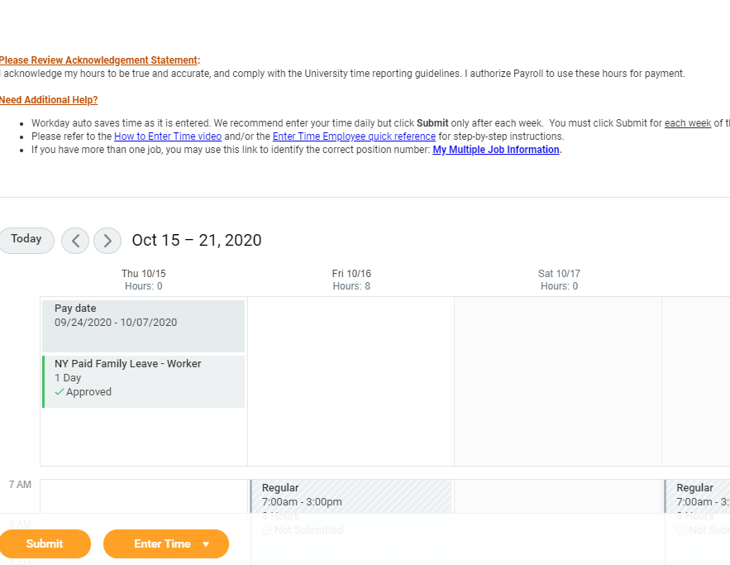
Viewing time/Time off totals (BW Employees)
View the timecard to view NYPFL days along with hours totals
Won’t be an even forty hours per week when NYPFL is used (ex: 32 hours, 1 NYPFL day)
Mass review:
Pay Rep reports updated to include a NYPFL Days column to view NYPFL days in tandem with hours

Slide 21
Timeline
Description | Timeline | Comments
Project Team enables new NYPFL Design in Workday Production | 1/4/2021 | Employees will have new rate applied starting January 1 for any days on NYPFL
Employees transitioned to new NYPFL leave type | 1/5/2021 | HRIS returns employees from existing NYPFL leave type HRIS places all employees with open claims on the new NYPFL leave type
Pay Reps/HR Reps/Manager time entry window | BW: 1/6-1/13 SM: 1/6-1/8 | Enter time off to indicate leave days used since 1/1/21
SM Payroll Cutoff | 1/8/2021 (5pm) | Deadline for all NYPFL time entry back to 1/1/2021
BW Payroll Cutoff | 1/14/2021 (Noon) | Deadline for all NYPFL time entry back to 1/1/2021
SM First Paycheck to include new daily rate | 1/15/2021
BW First Paycheck to include new daily rate | 1/21/2021

Slide 22
Need additional help?
Revised Job Aids
HR/Pay Rep/Manager
Employee (NEW)
Video Overview
NYPFL Support Lab Sessions
Available remotely via zoom in December & January
Remaining Questions
HRIS Helpdesk (HRPayrollSupport@cornell.edu)

Slide 23
Questions

Slide 24
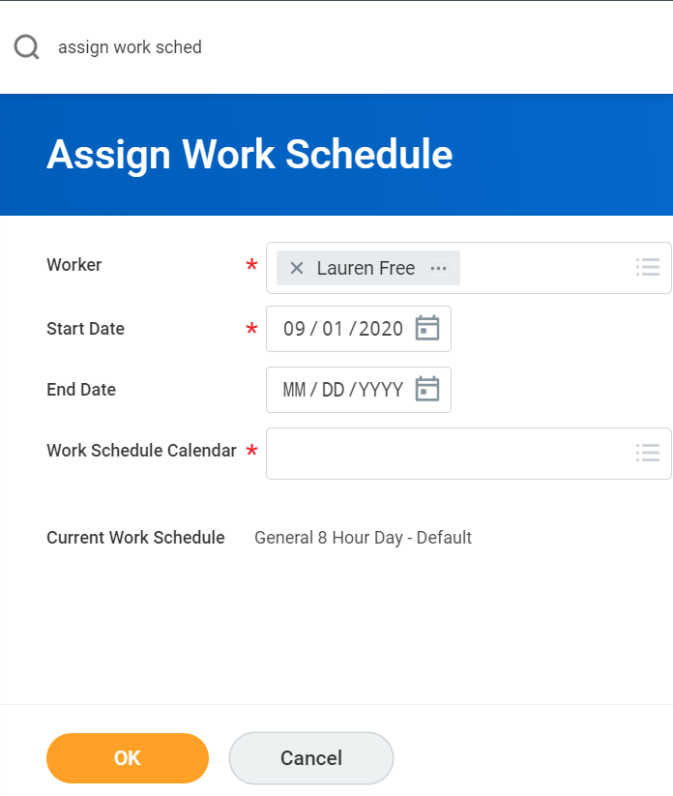
Work Schedules for SALARIED Employees
For salaried (semi-monthly) employees who do not work a standard workweek (Monday-Friday), the HR rep will need to update the work schedule.
Navigate to:
Worker profile
Actions
Time and leave
Assign Work Schedule

Slide 25
Where’s my work schedule?
If the work schedule does not yet exist in Workday, notify HRPayrollSupport@cornell.edu
Include: Specific days of the week that the employee works
Once the schedule is created in Workday, assign it to the employee

